Slide 1

Professional Practices (HUM-305)
SPRING SEMESTER 2026
By
Prof Engr Muhammad Raheel Iqbal Butt
Resource Person
Contact: +92 321 7433568
School of Computer & Information Technology
Beaconhouse National University, Lahore

Slide 2
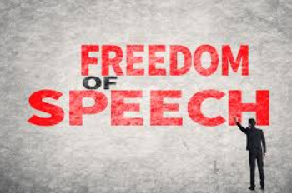

Slide 3
Chap 3: FREEDOM OF SPEECH
Communications Paradigms
Regulating Communications Media
Free Speech Principles
Controlling Speech
Offensive Speech: What Is It? What Is Illegal? Censorship Laws and Alternatives
Child Pornography and Sexting
Spam
Challenging Old Regulatory Structures and Special Interests
Posting, Selling, and Leaking Sensitive Material
Anonymity

Slide 4
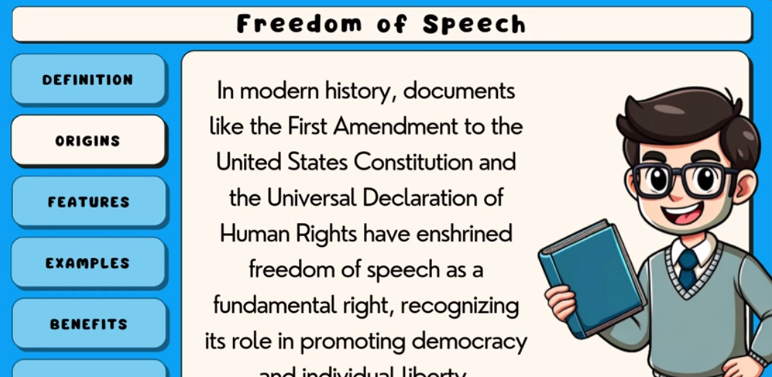
Video
https://youtu.be/Vz3KVBu6lxM

Slide 5
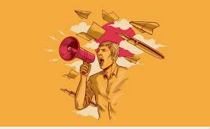

Slide 6
Communications Paradigms
Communications Paradigms
A communications paradigm refers to the model or structure through which information is created, transmitted, and received.
In CS & IT:
One-to-Many Model: Traditional media websites (e.g., news portals).
Many-to-Many Model: Social media platforms, discussion forums, GitHub collaboration.
Client-Server Model: Web applications where users request services from servers.
Peer-to-Peer (P2P): File-sharing networks like BitTorrent.
Example:
A cloud-based messaging app like WhatsApp uses a client-server paradigm, while blockchain networks use a decentralized paradigm.

Slide 7


Slide 8
Regulating Communications Media
Regulating Communications Media
Governments regulate digital communication to prevent misuse such as cybercrime, misinformation, or hate speech.
In IT Context:
Internet governance laws
Data protection regulations (e.g., GDPR-like laws)
Telecom regulations
Platform moderation policies
Example:
A government may require social media platforms to remove extremist content within 24 hours.

Slide 9
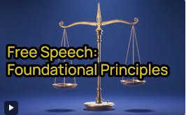

Slide 10
Free Speech Principles
Free Speech Principles
Free speech allows individuals to express opinions without government interference, but it is not absolute.
In CS & IT:
Social media posts
Blogging platforms
Online forums
YouTube content creation
Example:
A developer criticizing a software company on a tech blog is exercising free speech.

Slide 11
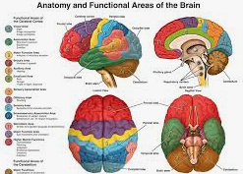

Slide 12
Controlling Speech
Controlling Speech
Speech may be controlled when it:
Incites violence
Promotes terrorism
Spreads harmful misinformation
Violates privacy
IT Example:
A platform using AI algorithms to remove hate speech or fake news.

Slide 13
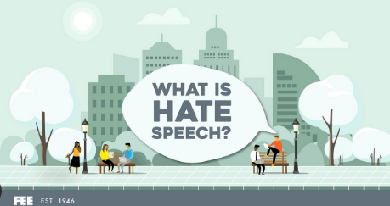

Slide 14
Offensive Speech: What Is It? What Is Illegal? Censorship Laws and Alternatives
Offensive Speech:
Speech that is insulting, abusive, or disturbing but not necessarily illegal.
Illegal Speech:
Hate speech
Threats
Defamation
Incitement to violence
IT Example:
Posting abusive comments on social media.
Spreading false allegations about a company (defamation).
Alternatives to Censorship:
Content moderation
Community guidelines
User reporting systems
Warning labels

Slide 15
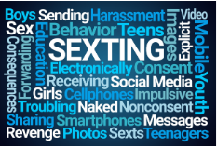

Slide 16
Child Pornography and Sexting
Child Pornography and Sexting
This is strictly illegal in most countries.
In IT Context:
Sharing explicit images of minors via messaging apps
Cloud storage misuse
Dark web distribution
CS Role:
AI detection tools to detect illegal content
Reporting mechanisms
Encryption challenges
Example:
Social media platforms using machine learning to detect and remove illegal images.

Slide 17
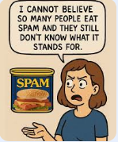

Slide 18
Spam
Spam
Spam refers to unwanted or unsolicited digital messages.
In IT:
Email spam
SMS spam
Bot-generated comments
Phishing emails
Example:
Receiving fake job offers asking for personal data.
IT Solution:
Spam filters
Machine learning classifiers
CAPTCHA systems

Slide 19
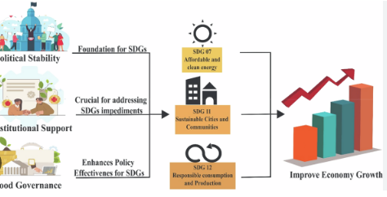

Slide 20
Challenging Old Regulatory Structures and Special Interests
Challenging Old Regulatory Structures and Special Interests
Digital technology challenges traditional laws.
Example:
Ride-sharing apps challenging taxi regulations.
Cryptocurrency challenging banking systems.
Online streaming challenging broadcast regulations.
IT Impact:
Governments struggle to update outdated laws for digital platforms.

Slide 21
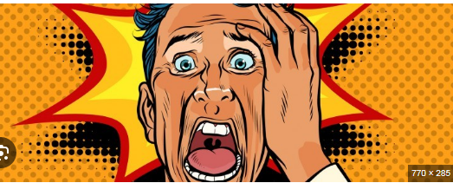

Slide 22
Posting, Selling, and Leaking Sensitive Material
Posting, Selling, and Leaking Sensitive Material
Sensitive material includes:
Personal data
Company trade secrets
Government classified data
IT Examples:
Data breaches
Hackers leaking databases
Insider selling customer data
Whistleblowers publishing confidential documents
Ethical Issue:
Balance between public interest and privacy/security.

Slide 23


Slide 24
Anonymity
Anonymity
Anonymity allows users to hide their identity online.
Benefits:
Protects whistleblowers
Encourages free expression
Protects political activists
Risks:
Cyberbullying
Online harassment
Dark web criminal activity
IT Example:
Anonymous browsing via Tor
Fake social media accounts

Slide 25
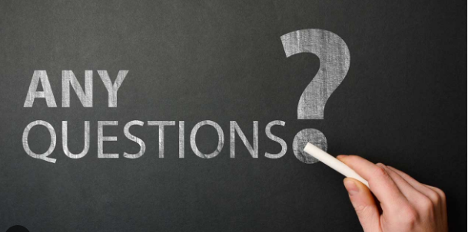

Slide 26


